Slide 1



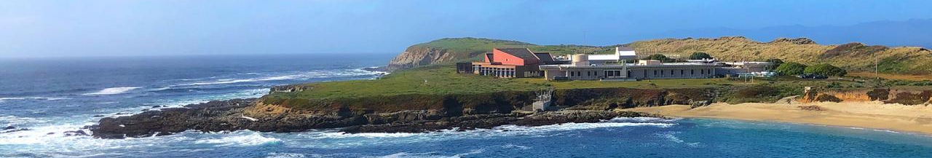
Welcome to our workshop!
Lunch: 12:30 – 1:30 pm
Bathrooms, fire exits
Waiver
UCD van departing @ 4:30 pm
Workshop notes: <https://jessicabolin.quarto.pub/esmrworkshop_notes/>
Notes:
Workshop materials Dropbox: https://www.dropbox.com/home/Conferences%20%26%20Workshops/2025/esmrworkshop/esmRworkshop_website
Notes: https://jessicabolin.quarto.pub/esmrworkshop_notes/

Slide 2
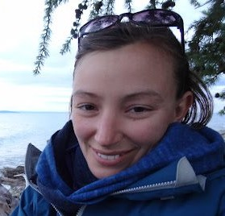
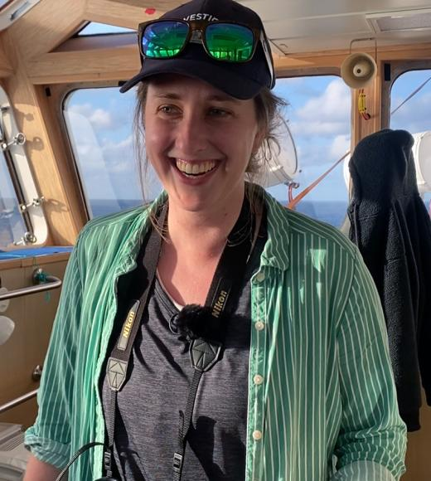





Welcome to our workshop!
Mikaela Provost | Jessica Bolin | Mer Pozo Buil | Nerea Lezama-Ochoa | Mary Fisher

Slide 3
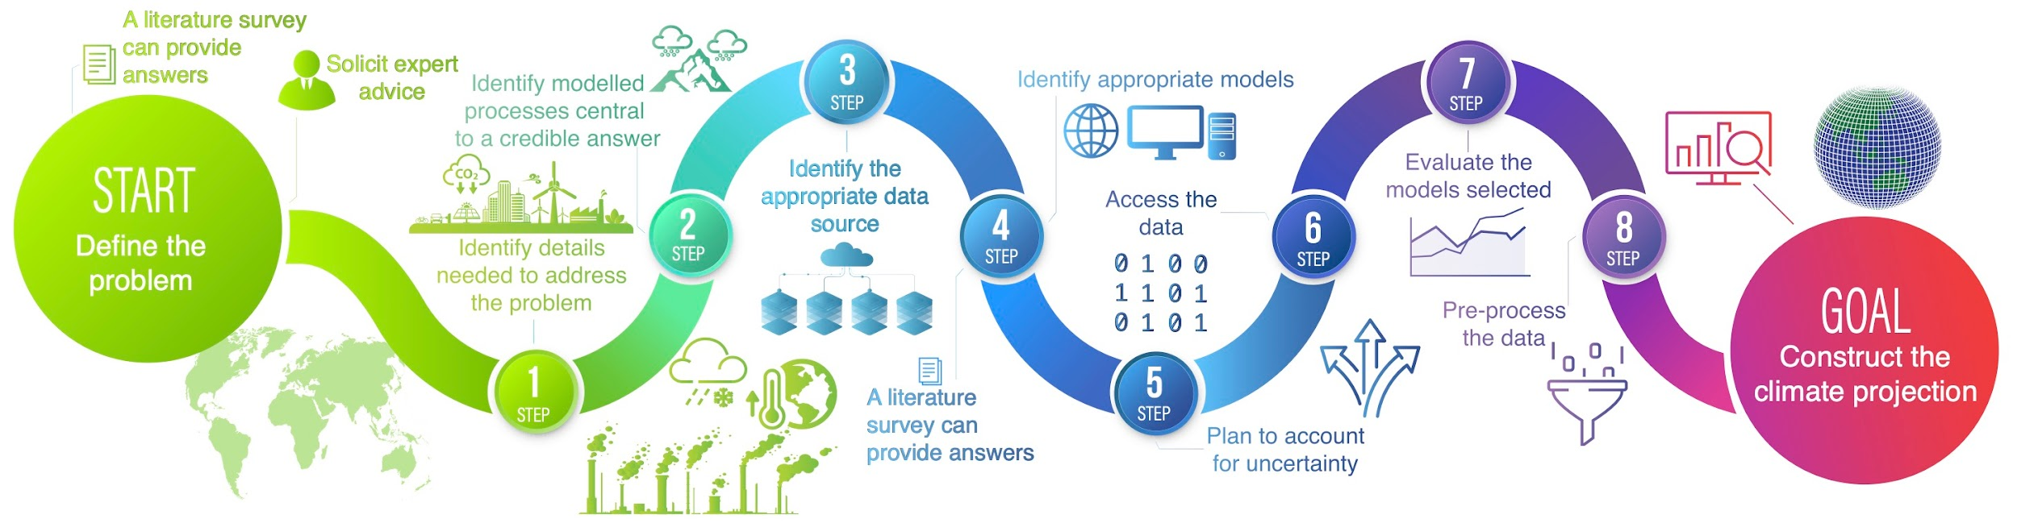
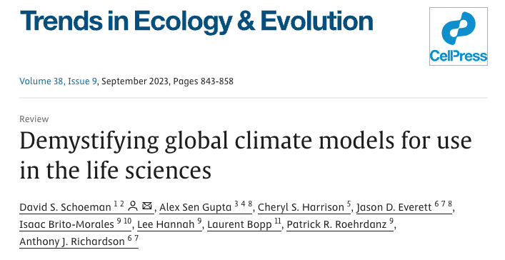
Notes:
Workshop is centered around Step 8 of the workflow presented in this paper here (preprocess the data). Great paper, highly recommend reading - paper designed for all ecologists but has an explicit focus on case studies centered around marine systems, plus the authors are all marine ecologists.

Slide 4
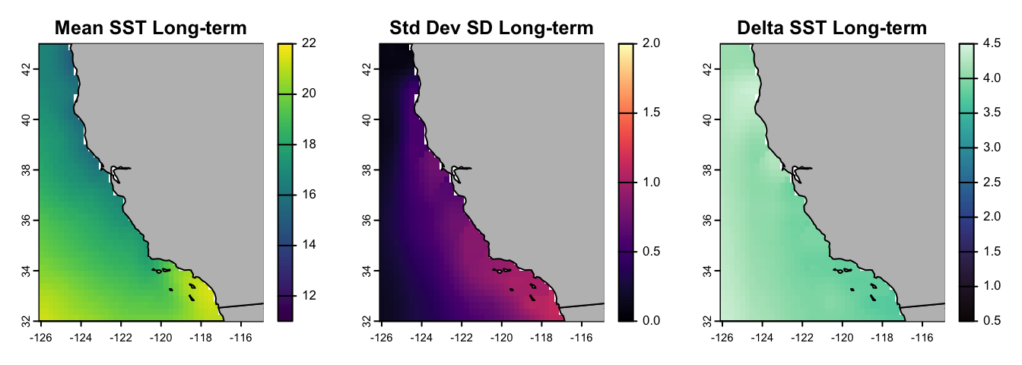
Producing projections of sea-surface temperature (SST) off California for two time periods across two climate scenarios
Time periods: (i) Near term: 2020-2040, (ii) Long term: 2080-2100
Scenarios: (i) SSP2-4.5, (ii) SSP5-8.5

Slide 5
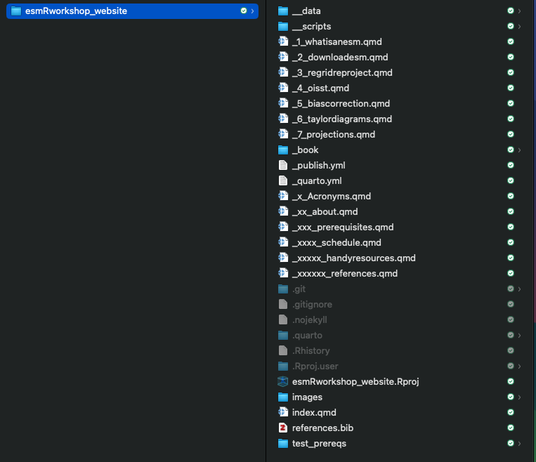
Contains data required + pre-computed outputs
.R and .sh scripts we’ll use for live-coding today
R project - open this first!

Slide 6
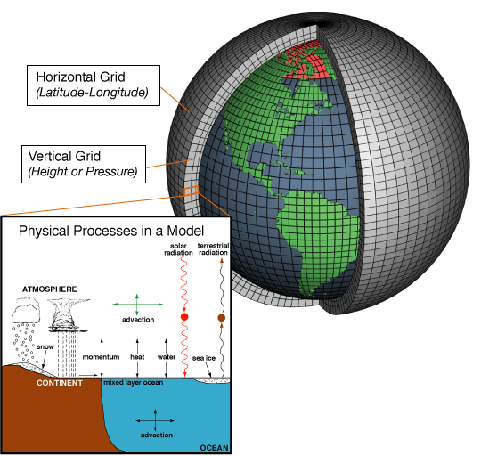
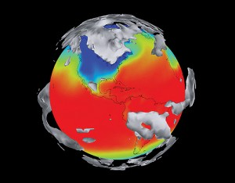
Climate model (i.e., Earth System model: ESM)
Notes:
A climate model is a numerical representation of the world. They use math laws and equations to simulate how climate has changed in the past, and how it might evolve in the future. They turn the world into a giant grid, within each grid cell, they simulate

Slide 7
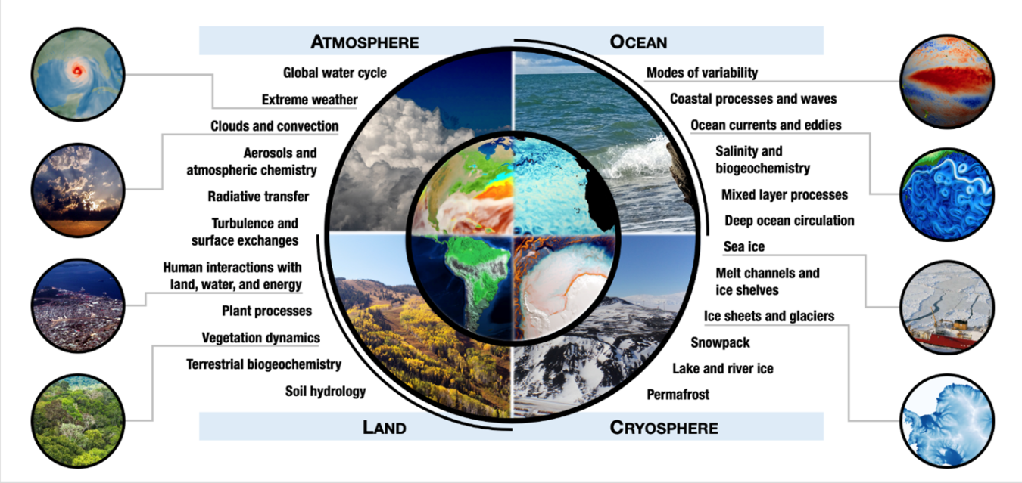
Notes:
the physical, chemical and biological processes that operate across the atmosphere, cryosphere, ocean and land, plus, how all of these components store and move heat and carbon between them that warm’s the earth’s atmosphere.

Slide 8
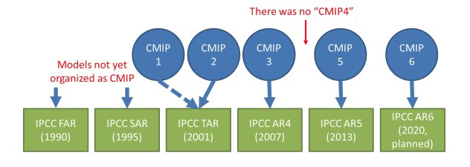


Notes:
CMIP is an international effort to improve climate models by comparing a bunch of model simulations to observations, and also to each other. These comparisons allow us to better understand past and future climate changes. CMIP has undergone 6 major intercomparison projects, and is currently in its 6th iteration. These models have been used a lot in various IPCC assessment reports since 1990. CMIP6 was used in support the IPCCs AR6 published in 2021.
The structure of a CMIP project is complex and kind of hard to get your head around.

Slide 9
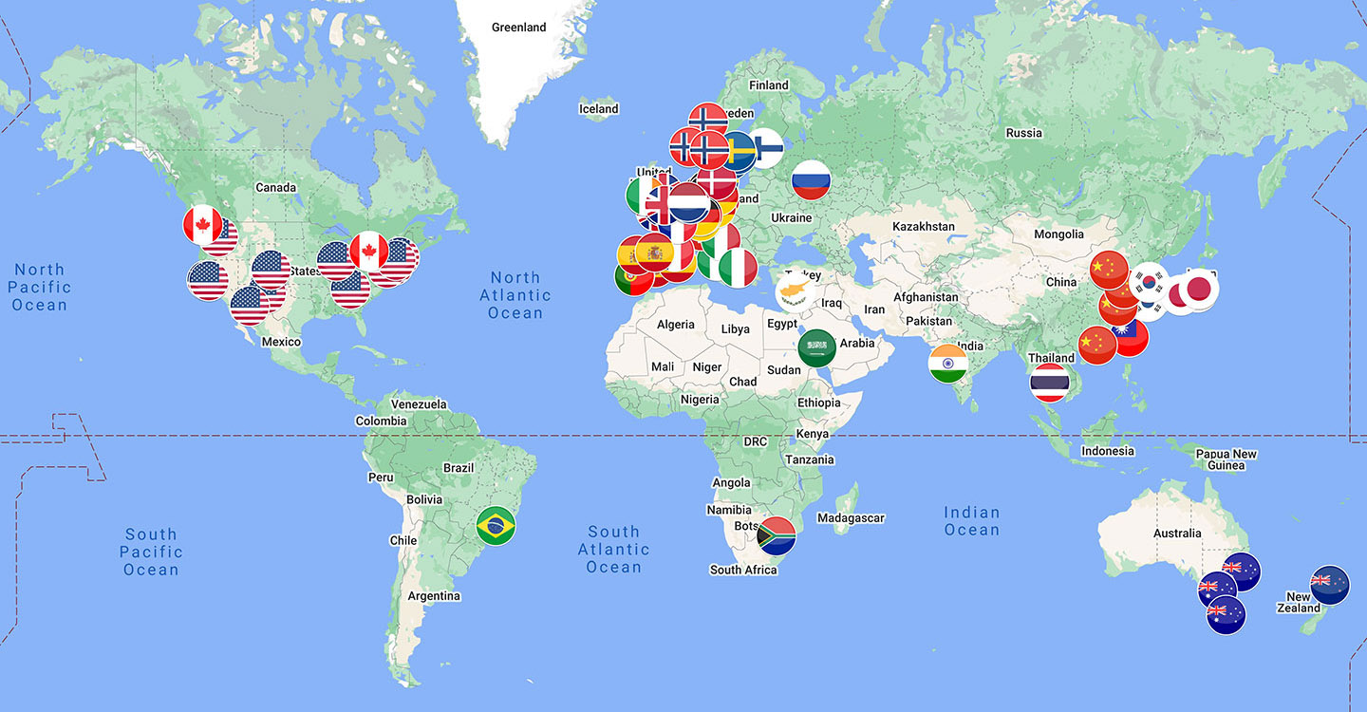
CMIP6: 99 ESMs across 49 modeling centers
https://wcrp-cmip.github.io/CMIP6_CVs/docs/CMIP6_institution_id.html
Notes:
So, there’s 99 models across a bunch of modelling cneters contributing to CMIP6. which you can see some of them here. You have centers in the US, China, Germany, Australia, Italy, all around the world. And each of these centers contributes one or more earth system models to the CMIP suite.

Slide 10
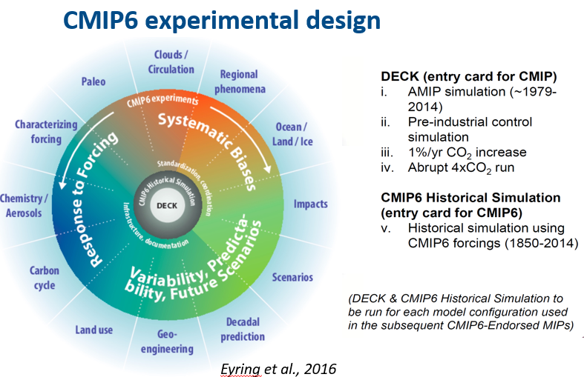
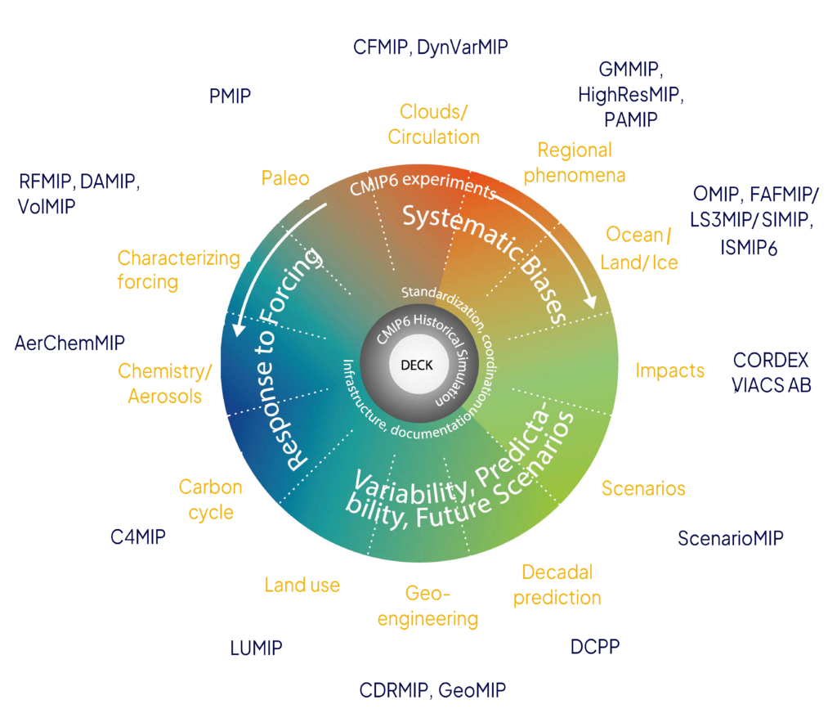
Notes:
So this image of the wheel demonstrates how a model within CMIP6 is designed. So, in the middle, you can see DECK. This is the entry card for being allowed to be in the CMIP suite. And the model HAS to run a minimum of four experiments within the DECK that are shown in the upper right. An experiment is specific model simulation protocol designed to investigate particular aspects of the climate system. Each experiment is defined by a standardized set of boundary conditions, forcing agents, and model configuration guidelines, allowing different climate modeling groups around the world to perform comparable simulations. So one experiment for example, is running projections of variables where they increase CO2 by 1% every year, for example.

Slide 11
Notes:
So that’s an overview of what an experiment means. Also, for a model to be included in CMIP6, we will move up to the grey circle from the deck. it has to include a historical simulation of past climate, where the model is run from 1850-2014. Every model within CMIP has a historical run, using standard CMIP observed forcings, so same observed greenhouse gas concentrations, solar irradiance, volcanic aerosols etc. So while I’ve explained what deck is, the only relevant aspect of this today, is the historical run, we’re going to be using the historical runs from two climate model configurations.

Slide 12
MIPS:
Model intercomparison experiments
Notes:
Then, after DECK and historical, the model can run a series of model intercomparison experiments, or MIPS that fit into different classes.
And these model intercomparison experiments answer key science questions of CMIP6. that So the model will run simulations that are about changes in chemistry/aerosols, others related to geo-engineering, others to ocean/land use.

Slide 13
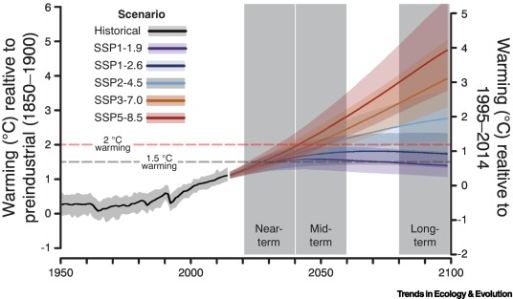
Notes:
Today, we’re going to use model runs that comprise experiments within ScenarioMIP. These are future climate scenarios based on greenhouse gas emissions and mitigation strategies that world governments take to curb emissions, called shared-socioeconomic pathways, or SSPs, that you might have heard of.

Slide 14
Scenario | Description | Warming relative to preindustrial (90% confidence interval)
SSP1-1.9 | Net zero CO₂ emissions achieved by mid-century; avoids exceeding 1.5°C of warming, in line with the ambition of the Paris Agreement | Stabilises at 1.4°C (1.0–1.8°C), with minimal overshoot beyond 1.5 °C
SSP1-2.6 | Net zero CO₂ emissions achieved in the latter part of this century; achieves the goals of the Paris Agreement by avoiding 2°C of warming | Stabilises at 1.8°C (1.3–2.4°C)
SSP2-4.5 | Approximates current climate policy, although this will change with commitments at each successive Conference of the Parties | 2.7°C (2.1–3.5°C) by 2100
SSP3-7.0 | Approximates a situation under which no new climate policy is implemented, resulting in a doubling of CO₂ by 2100 | 3.6°C (2.8–4.6°C) by 2100
SSP5-8.5 | An extreme counterfactual scenario under which CO₂ emissions double by mid-century and increase thereafter | 4.4°C (3.3–5.7°C) by 2100
Notes:
Here are the most-used SSPs. You can see that they all have different levels of warming related to the preindustrial period, and go up in terms of severity, - our first scenario stabilises global warming at 1.4˚C by mid-century, whereas our most extreme scenario, SSP585, will see 4.4˚C of warming by 2100, compared to the preindustrial.

Slide 15
Scenario | Description | Warming relative to preindustrial (90% confidence interval)
SSP1-1.9 | Net zero CO₂ emissions achieved by mid-century; avoids exceeding 1.5°C of warming, in line with the ambition of the Paris Agreement | Stabilises at 1.4°C (1.0–1.8°C), with minimal overshoot beyond 1.5 °C
SSP1-2.6 | Net zero CO₂ emissions achieved in the latter part of this century; achieves the goals of the Paris Agreement by avoiding 2°C of warming | Stabilises at 1.8°C (1.3–2.4°C)
SSP2-4.5 | Approximates current climate policy, although this will change with commitments at each successive Conference of the Parties | 2.7°C (2.1–3.5°C) by 2100
SSP3-7.0 | Approximates a situation under which no new climate policy is implemented, resulting in a doubling of CO₂ by 2100 | 3.6°C (2.8–4.6°C) by 2100
SSP5-8.5 | An extreme counterfactual scenario under which CO₂ emissions double by mid-century and increase thereafter | 4.4°C (3.3–5.7°C) by 2100
Notes:
Today, we are going to create projections of SST off california, for two of these scenarios. SSP245 (business as usual climate policy) and SSP585 (extreme emissions). In the literature, you often see these two scenarios used for projecting species distribution models and other effects on marine taxa etc, which is why we chose them.

Slide 16
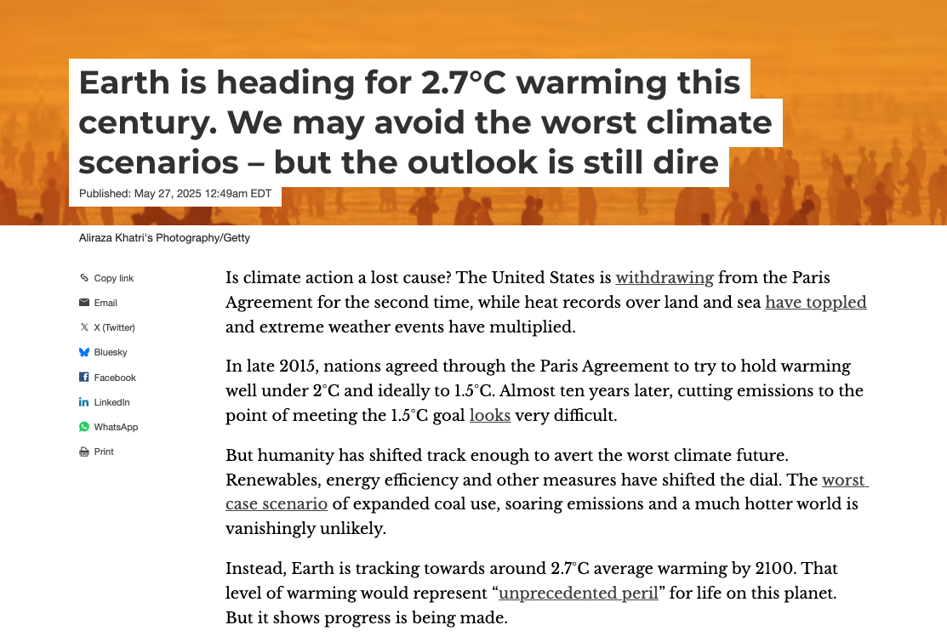

https://theconversation.com/earth-is-heading-for-2-7-c-warming-this-century-we-may-avoid-the-worst-climate-scenarios-but-the-outlook-is-still-dire-254284
Notes:
Also note this piece came out a few days in teh conversation that we’re headed to a 2.7˚C warmin world, which fits in exactly with teh SSP245 scenario. So, it looks like we won’t be lviign the SSP585 scenario, but we’re going to project it anyway.

Slide 17
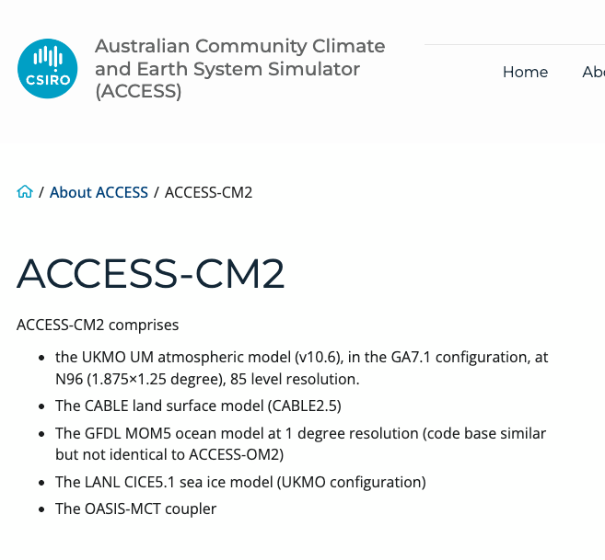
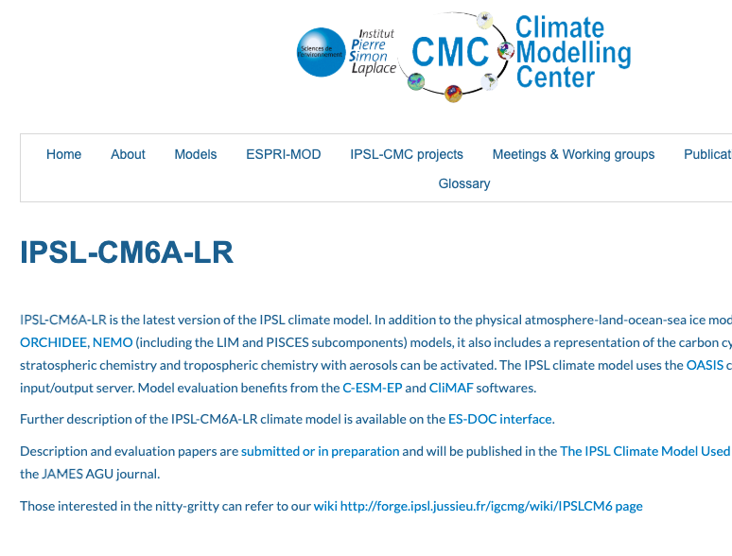


Notes:
Here are the two models that we’re using. There’s over 99 of them, and we are choosing one of teh Australian and French ones. Both of these models are configured differently - they incorporate different submodels, and incorporate different observational datasets etc.

Slide 18
BIAS CORRECTION

Slide 19
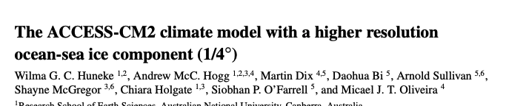
ACCESS-CM2 warm SST bias
TL;DR
SST in this model is too warm
Likely due to the parameterisation of clouds and aerosols in the atmospheric submodel
“Both CM2 configurations have a warm global mean SST bias with a similar spatial pattern. The positive bias is dominated by a too warm Southern Ocean, warm patches in the upwelling regions of the tropical eastern Pacific and Atlantic, and a too warm Indonesian Sea. Regions of cold biased SST exist in the mid-latitudes of the Northern Hemisphere Pacific and Atlantic as well as the high latitude Atlantic. The imbalanced geographical distribution of the warm and cold biases can largely be ascribed to the parameterisation of clouds and aerosols in the atmospheric model (Bi et al., 2020), explaining the similarity of the spatial patterns in CM2-025 and CM2-1.
Notes:
ACCESS-CM2 model for example, is know to have a global warm SST bias, meaning it might be producing projcetions that are too warm, realistically. This is likely to the parameterisation of clouds and aerosols in the atmospheric component of the climate model. And for this model in particular, the Southern Ocean is known to be way too hot, which affects the rest of the world. So, if we use this model as is, it will lead to erroneous or biased projections, which is a problem if we’re doing science (climate impact assessments, projections changes to species distributions). We want to be as accurate and reflective of reality as possible, so we can NEVER trust the raw output of a climate model.
https://egusphere.copernicus.org/preprints/2025/egusphere-2025-1006/egusphere-2025-1006.pdf

Slide 20
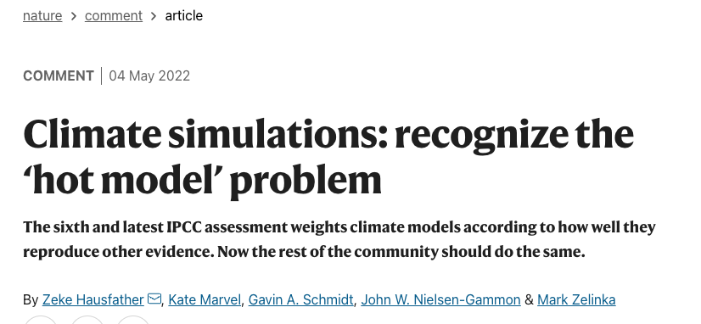
Bias correction
Errors or biases in climate models are due to limited spatial resolution (large grid sizes), simplified thermodynamic processes and physics or an incomplete understanding of the global climate system.
To overcome the large biases in climate models, a range of bias correction methods have been developed.
The simplest approach is the Delta change method (sometimes referred to as the ‘change factor’ method), which is often used in climate impact research.
Notes:
Errors in climate models can be due to coarse spatial resolution, simplification of earth system physics and thermodynamic processes, and an incomplete understanding of the global climate system. These models simply cannot resolve every single physical process that exists in the earth’s climate, so that leads to bias, and potentially erroneous projections.
BUT, in an attempt to try and overcome these biases, we can implement a technique called bias correction. There are many different ways to go about bias correction, some are easy, some are difficult and each have their pros and cons. Today, we’re going to show an example of the simplest approach, called delta change bias correction.
https://climate.copernicus.eu/sites/default/files/2021-01/infosheet7.pdf

Slide 21
Delta-change bias correction
1. Create mean/climatology of OISST observational dataset over baseline period (i.e., 1995-2014)
2. Repeat the above for the ESM
3. For each monthly ESM projection, subtract the ESM climatology (step 2) to create anomalies
4. Interpolate ESM anomalies to the OISST grid using a land mask
5. Perform delta-change bias correction by adding the OISST climatology (step 1) to the remapped ESM anomalies (step 4).
Notes:
These are the steps we are going to walk through. This will make sense as we’re doing it, but essentially, we need to use our observed SST dataset from OISST to create a climatology during a baseline period, and add that climatology to SST anomalies we create using the projections from ESMs. The whole point of this is to remove mean state biases within the ESM, so that they’re more reflective of reality.

Slide 22
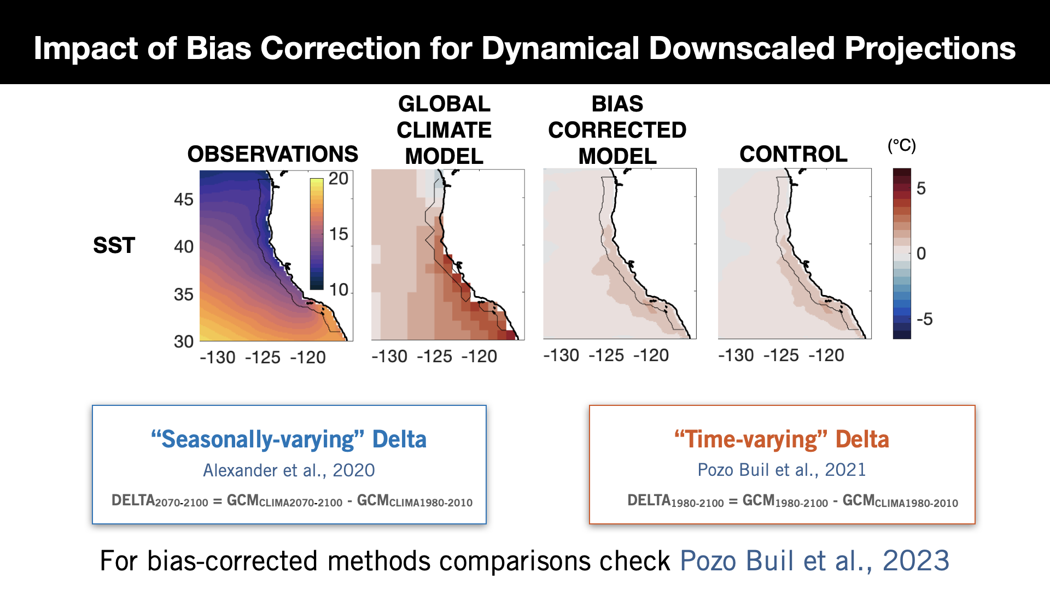
Notes:
References:
Alexander et al., 2020: https://doi.org/10.1175/JCLI-D-19-0117.1
Pozo Buil et al., 2021: https://doi.org/10.3389/fmars.2021.612874
Pozo Buil et al., 2023: https://doi.org/10.1029/2023EA003121

